Slide 1
NOTE

Slide 2
Project Team Member
Yuming JAING 460444981
Yuhao CHENG 450580673

Slide 3

Problem
What to eat?

Slide 4
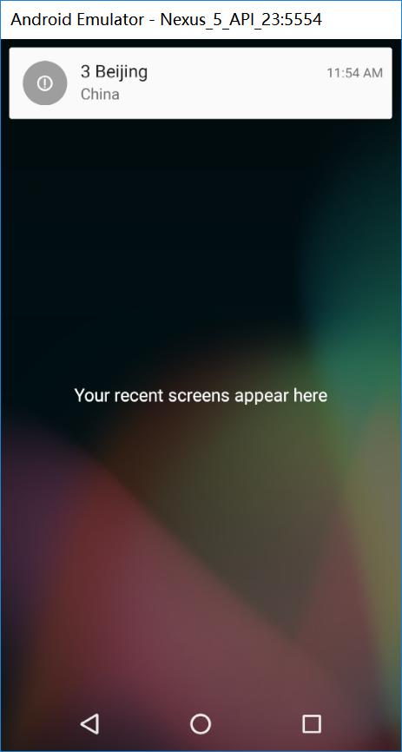
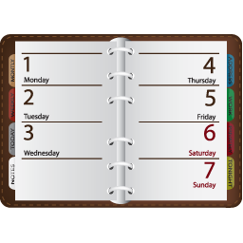
Solution
NOTE!

Slide 5
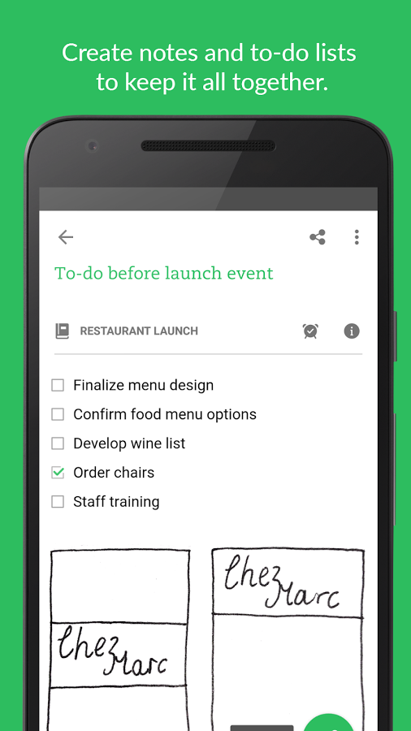
Evernote
World’s famous Note-Taking App
Sort by time
Sort by location
Alert by time
No Location Notification
NOTE
Sort by time
Sort by location
Alert by time
Location Notification

Slide 6
Location Notification in Background
So easy to use!

Slide 7
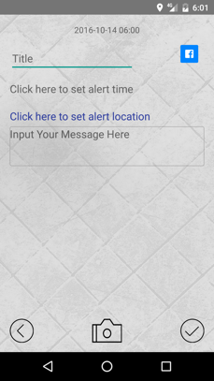

Slide 8
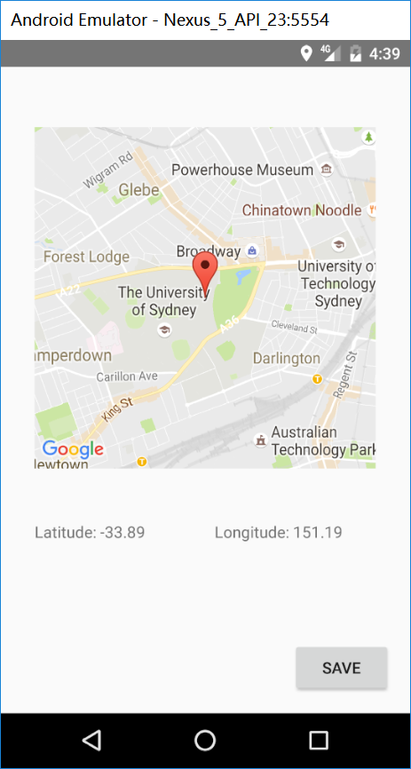

Slide 9
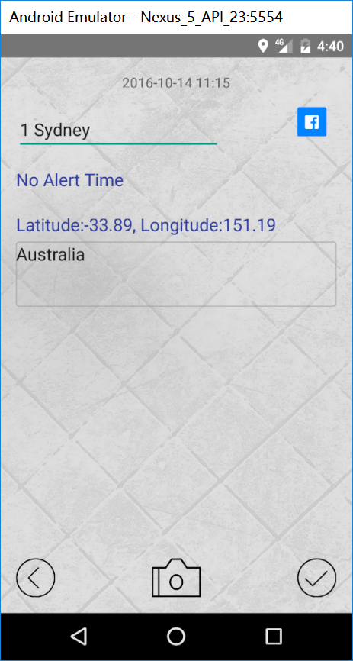

Slide 10
So many useful functions
1. login with Facebook account
2. Share the note with Facebook
3. Set an alert time
4. Sort the notes
5. Insert photo into the note
6. Many other functions

Slide 11
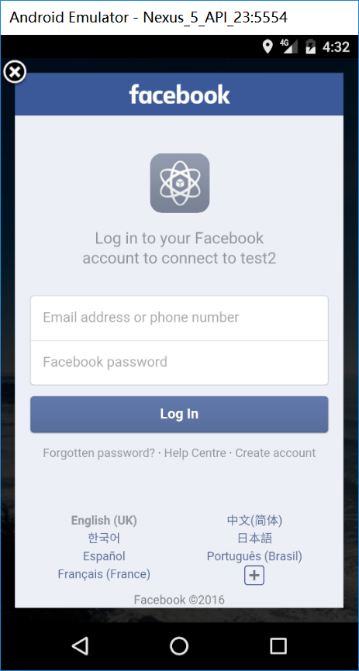

Slide 12
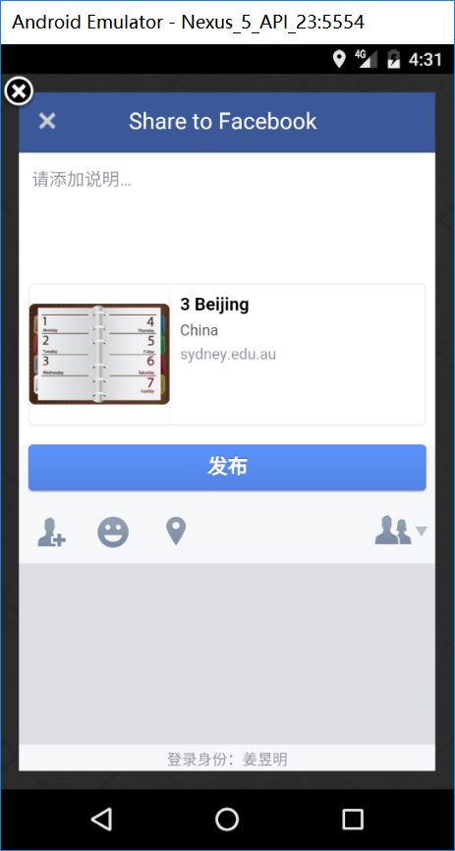

Slide 13
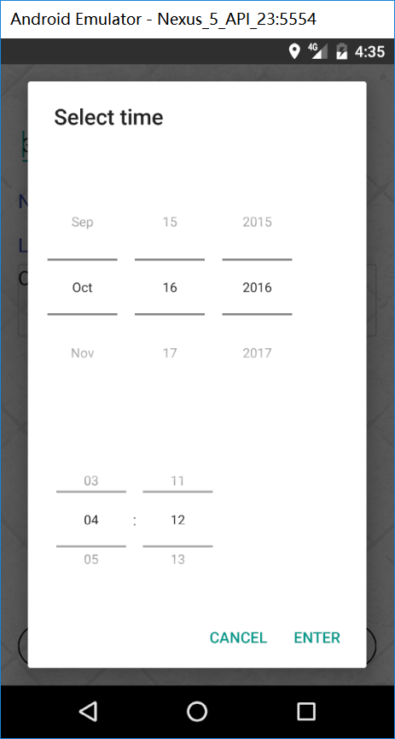

Slide 14
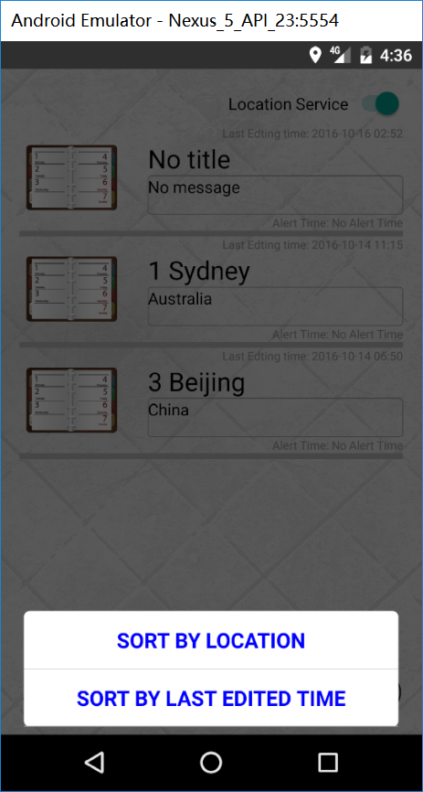

Slide 15
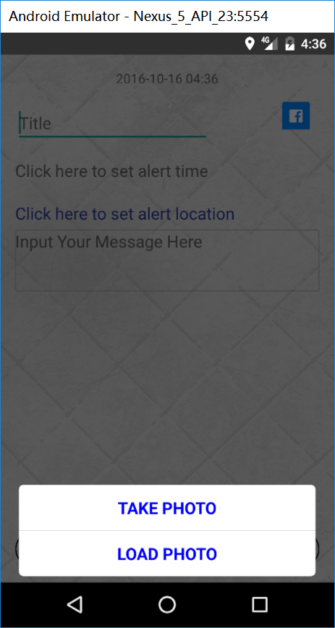

Slide 16
Just install note and prepare for tomorrow

